Slide 1
Naïve Bayes, Bayesian Learning

Slide 2
Agenda
Introduction
What is Machine Learning?
Roles for Bayesian Methods
MATHEMATICAL FORMULA FOR NAIVE BAYES
What is Naive Bayes Algorithm?
How Naive Bayes Algorithm Work?
Advantage and Disadvantage
Research Paper
Results
Comment

Slide 3
Introduction
Statistical method for classification.
Supervised Learning Method.
Assumes an underlying probabilistic model, the Bayes theorem.
Can solve problems involving both categorical and continuous valued attributes.
Named after Thomas Bayes, who proposed the Bayes Theorem.

Slide 4
What is Machine Learning?
Definition: A computer program is said to learn from experience E when its performance P at a task T improves with experience E.
Examples:
• Learning to recognize spoken words
• Learning to drive a vehicle
• Learning to play backgammon

Slide 5
Roles for Bayesian Methods
1. Provide practical learning algorithms:
Naïve Bayes learning
Bayesian belief network learning
Combine prior knowledge (prior probabilities) with observed data
2. Requires prior probabilities:
Provides useful conceptual framework:
Provides “gold standard” for evaluating other learning algorithms
Additional insight into Occam’s razor

Slide 6
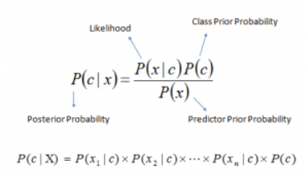
MATHEMATICAL FORMULA FOR NAIVE BAYES
Where,
P(c|x) is the posterior probability of class c
given predictor ( features).
P(c) is the probability of class.
P(x|c) is the likelihood which is the probability of predictor given class.
P(x) is the prior probability of predictor.

Slide 7
What is Naive Bayes Algorithm?
It is a classification technique based on Bayes’ Theorem with an assumption of independence among predictors. In simple terms, a Naive Bayes classifier assumes that the presence of a particular feature in a class is unrelated to the presence of any other feature.
Naive Bayes model is easy to build and particularly useful for very large data sets. Along with simplicity, Naive Bayes is known to outperform even highly sophisticated classification methods.

Slide 8
NAÏVE BAYES Algorithm
Naive Bayes is the most simple algorithm that we can apply to your data.
As the name suggests, here this algorithm makes an assumption as all the variables in the dataset is “Naive” i.e not correlated to each other.
Naive Bayes is a very popular classification algorithm that is mostly used to get the base accuracy of the dataset.

Slide 9
How Naive Bayes Algorithm Work?
Let us understand the working of the Naive Bayes Algorithm:
Step 1: Make Frequency Tables Using Data Sets
Step 2: Make a likelihood table by calculating the probabilities of each condition.
Step 3: Now, we need to calculate the probability using the Naive Bayes equation for each class.

Slide 10
Application
Real time Prediction
Multi class Prediction
Text classification/ Spam Filtering/ Sentiment Analysis
Recommendation System

Slide 11
Advantages of Naive Bayes
Easy to implement.
It requires less training data.
It can make probabilistic predictions.
Can handle both continuous and discrete data.
Easy to update on the arrival of new data.
Best suited for text classification problems.

Slide 12
Disadvantages of Naive Bayes
The strong assumption about the features to be independent is hardly true in real-life applications.
Data scarcity.
Chances of loss of accuracy.
Zero Frequency.

Slide 13
Research Paper
Title: Naive Bayes for Text Classification with Unbalanced Classes
Authors: Eibe Frank and Remco R. Bouckaert
Methodology:
In this paper we identify a potential deficiency of MNB in the context of skewed class sizes. We investigate the use of distinct initial word counts for different-size classes, and propose a heuristic for choosing the initial word count for each class. We also compare the modified version of MNB to the centroid classifier, to which it is closely related.

Slide 14
Research Paper
Steps/Working:
Step1: Our experiments is based on four well-known text classification datasets: Reuters-21578, WebKB, Industry Sector, and 20 Newsgroups.
Step2: For each dataset we created as many two-class classification problems as there were class values in the data, with the exception of the Reuters-21578 data where we only used the 10 most frequent categories.

Slide 15
Research Paper
Steps/Working:
Step3: Consequently we created 10 classification problems from the Reuters-21578 data, four from the WebKB data, 105 from the Industry Sector data, and 20 from the 20 Newsgroups data.
Step4: For each dataset we used the same steps to extract word features.
Step5: All characters were converted to lowercase, only alphabetic tokens were considered, stop words and hapax legomena were removed, and the full resulting vocabulary was used.

Slide 16
Research Paper
Steps/Working:
Step6: The results show that our modification significantly improves the performance of MNB on three of the ten Reuters-21578 categories.
Step7: There are eight wins and only two losses. This win/loss ratio has a p-value of 0.11 according to a two-sided sign test.

Slide 17
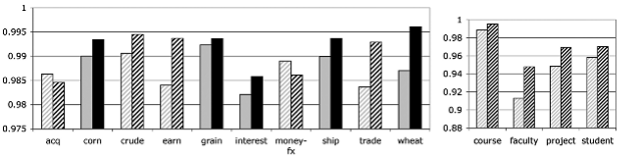
Results
We present experiments comparing MNB with and without our modification, and the centroid classifier.
All results are averages from ten runs of the hold-out method. For each run 66% of the data was used for training and 34% for testing.

Slide 18
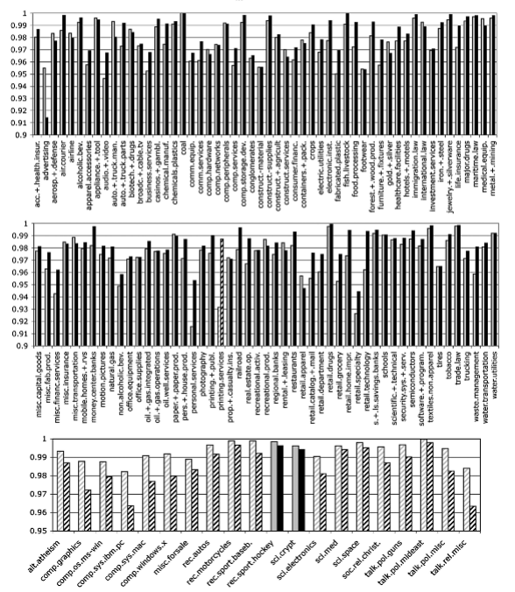
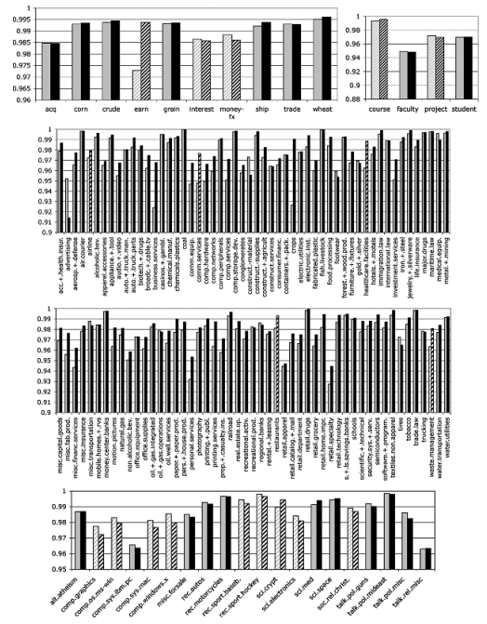
Results
AUC for MNB (grey) and MNBPCN (black) on Reuters (top left), WebKB (top right), Industry Sector (two middle graphs), and 20 Newsgroups (bottom)

Slide 19
Comment
We identified a potential deficiency of MNB in the context of unbalanced datasets.
The per-class word vector normalization presents a way to address the problem.
Empirical results show that normalization can indeed significantly improve performance.
MNB with class vector normalization is very closely related to the standard centroid classifier for text classification

Slide 20
Thank You

